Slide 1
Cache Organization

Slide 2
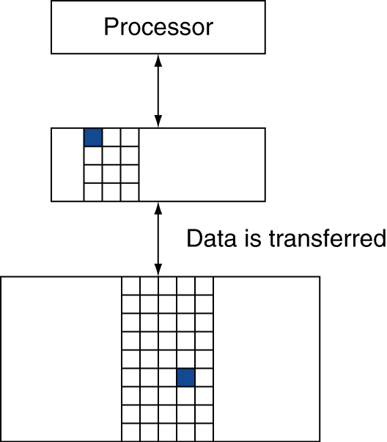
Memory Hierarchy Levels
Block (aka line): unit of copying
May be multiple words
If accessed data is present in upper level
Hit: access satisfied by upper level
Hit ratio: hits/accesses
If accessed data is absent
Miss: block copied from lower level
Time taken: miss penalty
Miss ratio: misses/accesses = 1 – hit ratio
Then accessed data supplied from upper level

Slide 3
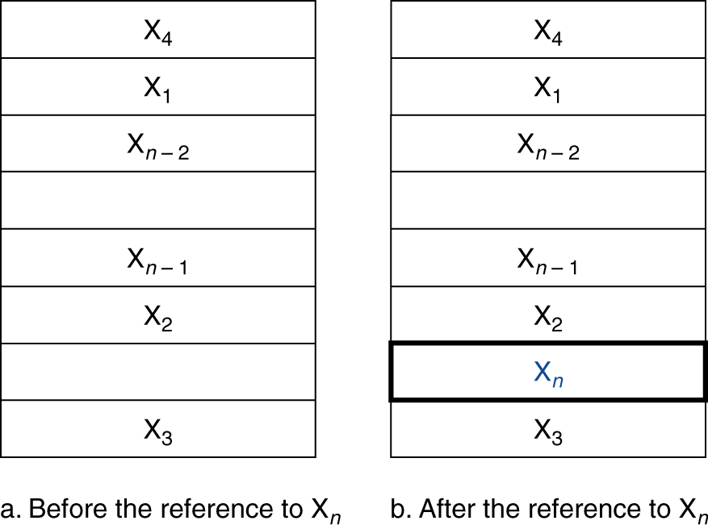
Cache Memory
Cache memory
The level of the memory hierarchy closest to the CPU
Given accesses X₁, …, X_{n–1}, X_{n}
§5.2 The Basics of Caches
How do we know if the data is present?
Where do we look?

Slide 4
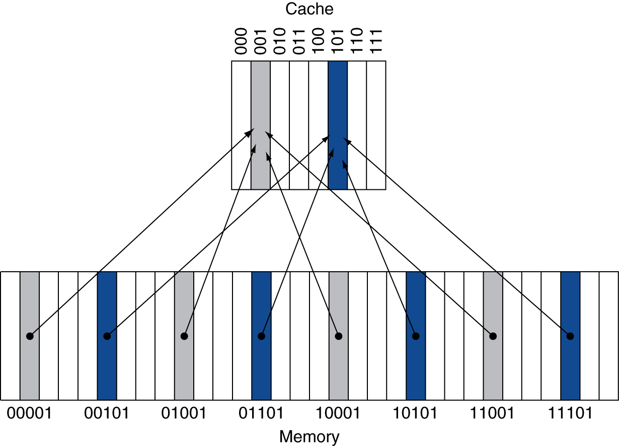
Direct Mapped Cache
Location determined by address
Direct mapped: only one choice
(Block address) modulo (#Blocks in cache)
#Blocks is a power of 2
Use low-order address bits

Slide 5
Tags and Valid Bits
How do we know which particular block is stored in a cache location?
Store block address as well as the data
Actually, only need the high-order bits
Called the tag
What if there is no data in a location?
Valid bit: 1 = present, 0 = not present
Initially 0

Slide 6
Cache Example
8-blocks, 1 word/block, direct mapped
Initial state
Index | V | Tag | Data
000 | N
001 | N
010 | N
011 | N
100 | N
101 | N
110 | N
111 | N

Slide 7
Cache Example
Word addr | Binary addr | Hit/miss | Cache block
22 | 10 110 | Miss | 110
Index | V | Tag | Data
000 | N
001 | N
010 | N
011 | N
100 | N
101 | N
110 | Y | 10 | Mem[10110]
111 | N

Slide 8
Cache Example
Word addr | Binary addr | Hit/miss | Cache block
26 | 11 010 | Miss | 010
Index | V | Tag | Data
000 | N
001 | N
010 | Y | 11 | Mem[11010]
011 | N
100 | N
101 | N
110 | Y | 10 | Mem[10110]
111 | N

Slide 9
Cache Example
Word addr | Binary addr | Hit/miss | Cache block
22 | 10 110 | Hit | 110
26 | 11 010 | Hit | 010
Index | V | Tag | Data
000 | N
001 | N
010 | Y | 11 | Mem[11010]
011 | N
100 | N
101 | N
110 | Y | 10 | Mem[10110]
111 | N

Slide 10
Cache Example
Word addr | Binary addr | Hit/miss | Cache block
16 | 10 000 | Miss | 000
3 | 00 011 | Miss | 011
16 | 10 000 | Hit | 000
Index | V | Tag | Data
000 | Y | 10 | Mem[10000]
001 | N
010 | Y | 11 | Mem[11010]
011 | Y | 00 | Mem[00011]
100 | N
101 | N
110 | Y | 10 | Mem[10110]
111 | N

Slide 11
Cache Example
Word addr | Binary addr | Hit/miss | Cache block
18 | 10 010 | Miss | 010
Index | V | Tag | Data
000 | Y | 10 | Mem[10000]
001 | N
010 | Y | 10 | Mem[10010]
011 | Y | 00 | Mem[00011]
100 | N
101 | N
110 | Y | 10 | Mem[10110]
111 | N

Slide 12
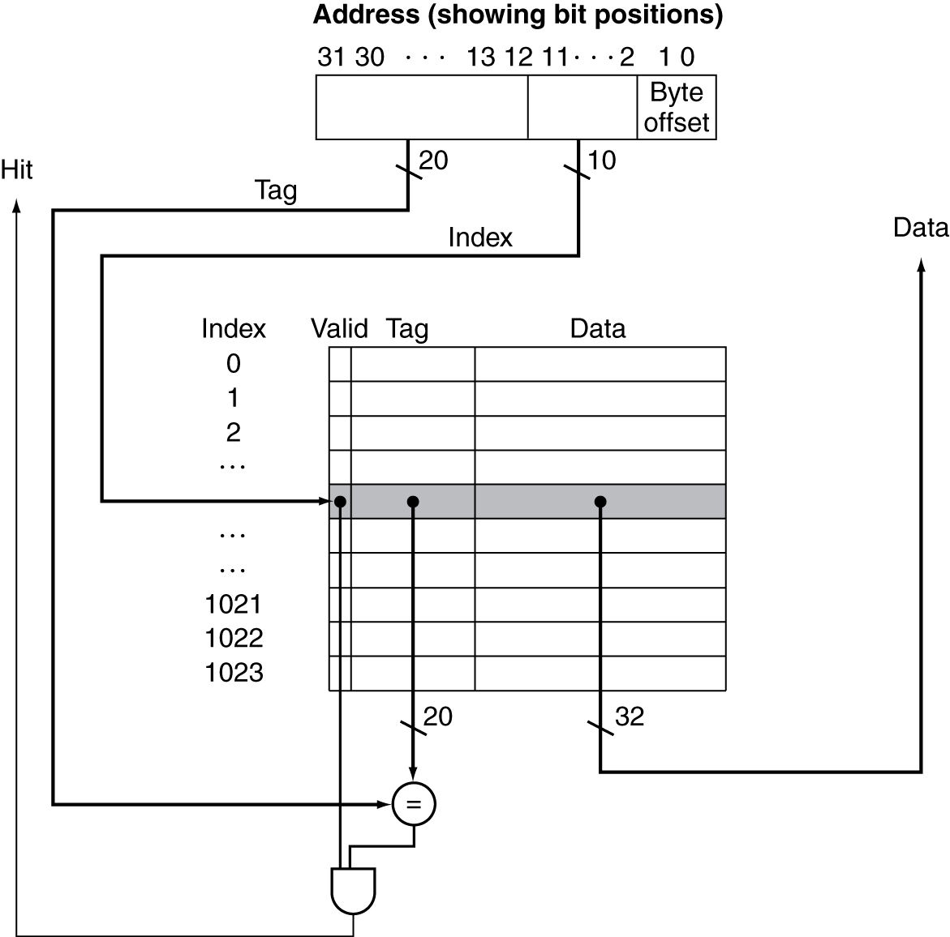
Address Subdivision

Slide 13
Example: Larger Block Size
64 blocks, 16 bytes/block
To what block number does address 1200 map?
Block address = ⎣1200/16⎦ = 75
Block number = 75 modulo 64 = 11
31
10
9
4
3
0
Tag
Index
Offset
22 bits
6 bits
4 bits

Slide 14
Block Size Considerations
Larger blocks should reduce miss rate
Due to spatial locality
But in a fixed-sized cache
Larger blocks ⇒ fewer of them
More competition ⇒ increased miss rate
Larger blocks ⇒ pollution
Larger miss penalty
Can override benefit of reduced miss rate
Early restart and critical-word-first can help

Slide 15
Block Size Tradeoff
In general, larger block size take advantage of spatial locality BUT:
Larger block size means larger miss penalty:
Takes longer time to fill up the block
If block size is too big relative to cache size, miss rate will go up
Too few cache blocks
In general, Average Access Time:
= Hit Time x (1 - Miss Rate) + Miss Penalty x Miss Rate
Average
Access
Time
Miss
Penalty
Miss
Rate
Exploits Spatial Locality
Increased Miss Penalty
& Miss Rate
Fewer blocks:
compromises
temporal locality
Block Size
Block Size
Block Size

Slide 16
Extreme Example: single big line
Valid Bit
Cache Tag
Cache Data
Byte 3
Byte 2
Byte 1
Byte 0
0
Cache Size = 4 bytes Block Size = 4 bytes
Only ONE entry in the cache
If an item is accessed, likely that it will be accessed again soon
But it is unlikely that it will be accessed again immediately!!!
The next access will likely to be a miss again
Continually loading data into the cache but discard (force out) them before they are used again
Worst nightmare of a cache designer: Ping Pong Effect
Conflict Misses are misses caused by:
Different memory locations mapped to the same cache index
Solution 1: make the cache size bigger
Solution 2: Multiple entries for the same Cache Index

Slide 17
Cache Misses
On cache hit, CPU proceeds normally
On cache miss
Stall the CPU pipeline
Fetch block from next level of hierarchy
Instruction cache miss
Restart instruction fetch
Data cache miss
Complete data access

Slide 18
Write-Through
On data-write hit, could just update the block in cache
But then cache and memory would be inconsistent
Write through: also update memory
But makes writes take longer
e.g., if base CPI = 1, 10% of instructions are stores, write to memory takes 100 cycles
Effective CPI = 1 + 0.1×100 = 11
Solution: write buffer
Holds data waiting to be written to memory
CPU continues immediately
Only stalls on write if write buffer is already full

Slide 19
Write-Back
Alternative: On data-write hit, just update the block in cache
Keep track of whether each block is dirty
When a dirty block is replaced
Write it back to memory
Can use a write buffer to allow replacing block to be read first

Slide 20
Write Allocation
What should happen on a write miss?
Alternatives for write-through
Allocate on miss: fetch the block
Write around: don’t fetch the block
Since programs often write a whole block before reading it (e.g., initialization)
For write-back
Usually fetch the block

Slide 21
Measuring Cache Performance
Components of CPU time
Program execution cycles
Includes cache hit time
Memory stall cycles
Mainly from cache misses
With simplifying assumptions:
§5.3 Measuring and Improving Cache Performance

Slide 22
Cache Performance Example
Given
I-cache miss rate = 2%
D-cache miss rate = 4%
Miss penalty = 100 cycles
Base CPI (ideal cache) = 2
Load & stores are 36% of instructions
Miss cycles per instruction
I-cache: 0.02 × 100 = 2
D-cache: 0.36 × 0.04 × 100 = 1.44
Actual CPI = 2 + 2 + 1.44 = 5.44
Ideal CPU is 5.44/2 =2.72 times faster

Slide 23
Average Access Time
Hit time is also important for performance
Average memory access time (AMAT)
AMAT = Hit time + Miss rate × Miss penalty
Example
CPU with 1ns clock, hit time = 1 cycle, miss penalty = 20 cycles, I-cache miss rate = 5%
AMAT = 1 + 0.05 × 20 = 2ns
2 cycles per instruction

Slide 24
Performance Summary
When CPU performance increased
Miss penalty becomes more significant
Decreasing base CPI
Greater proportion of time spent on memory stalls
Increasing clock rate
Memory stalls account for more CPU cycles
Can’t neglect cache behavior when evaluating system performance

Slide 25
Associative Caches
Fully associative
Allow a given block to go in any cache entry
Requires all entries to be searched at once
Comparator per entry (expensive)
n-way set associative
Each set contains n entries
Block number determines which set
(Block number) modulo (#Sets in cache)
Search all entries in a given set at once
n comparators (less expensive)

Slide 26
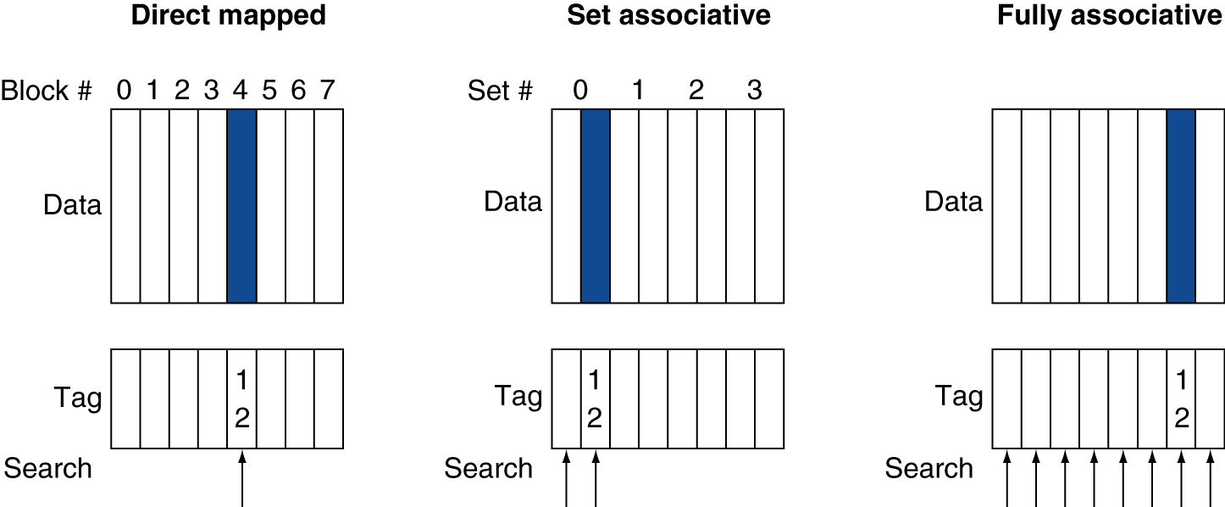
Associative Cache Example

Slide 27
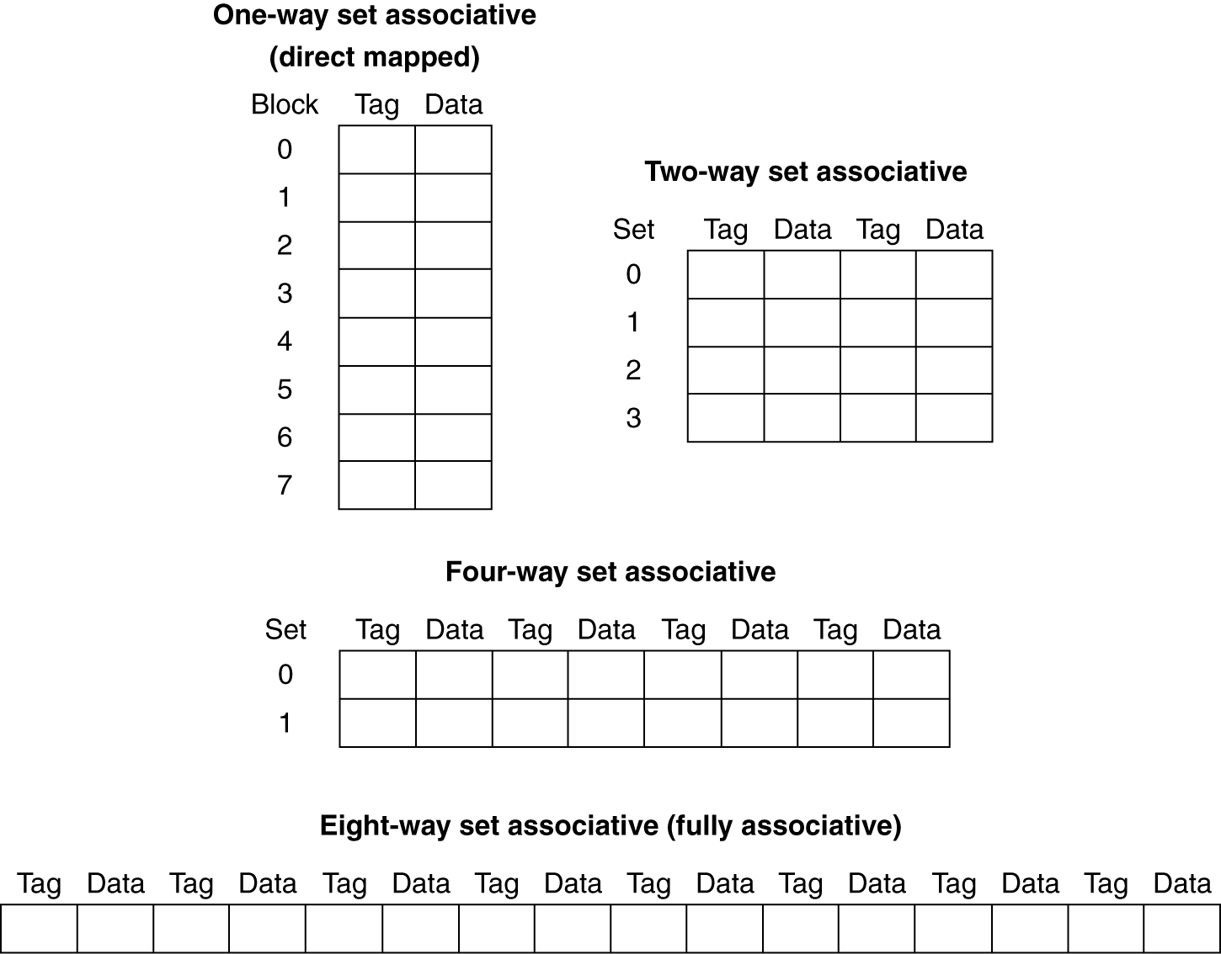
Spectrum of Associativity
For a cache with 8 entries

Slide 28
Associativity Example
Compare 4-block caches
Direct mapped, 2-way set associative, fully associative
Block access sequence: 0, 8, 0, 6, 8
Direct mapped
Block address | Cache index | Hit/miss | Cache content after access
 |  |  | 0 | 1 | 2 | 3
0 | 0 | miss | Mem[0]
8 | 0 | miss | Mem[8]
0 | 0 | miss | Mem[0]
6 | 2 | miss | Mem[0] |  | Mem[6]
8 | 0 | miss | Mem[8] |  | Mem[6]

Slide 29
Associativity Example
2-way set associative
Block address | Cache index | Hit/miss | Cache content after access
 |  |  | Set 0 |  | Set 1
0 | 0 | miss | Mem[0]
8 | 0 | miss | Mem[0] | Mem[8]
0 | 0 | hit | Mem[0] | Mem[8]
6 | 0 | miss | Mem[0] | Mem[6]
8 | 0 | miss | Mem[8] | Mem[6]
Fully associative
Block address |  | Hit/miss | Cache content after access
0 |  | miss | Mem[0]
8 |  | miss | Mem[0] | Mem[8]
0 |  | hit | Mem[0] | Mem[8]
6 |  | miss | Mem[0] | Mem[8] | Mem[6]
8 |  | hit | Mem[0] | Mem[8] | Mem[6]

Slide 30
How Much Associativity
Increased associativity decreases miss rate
But with diminishing returns
Simulation of a system with 64KB D-cache, 16-word blocks, SPEC2000
1-way: 10.3%
2-way: 8.6%
4-way: 8.3%
8-way: 8.1%

Slide 31
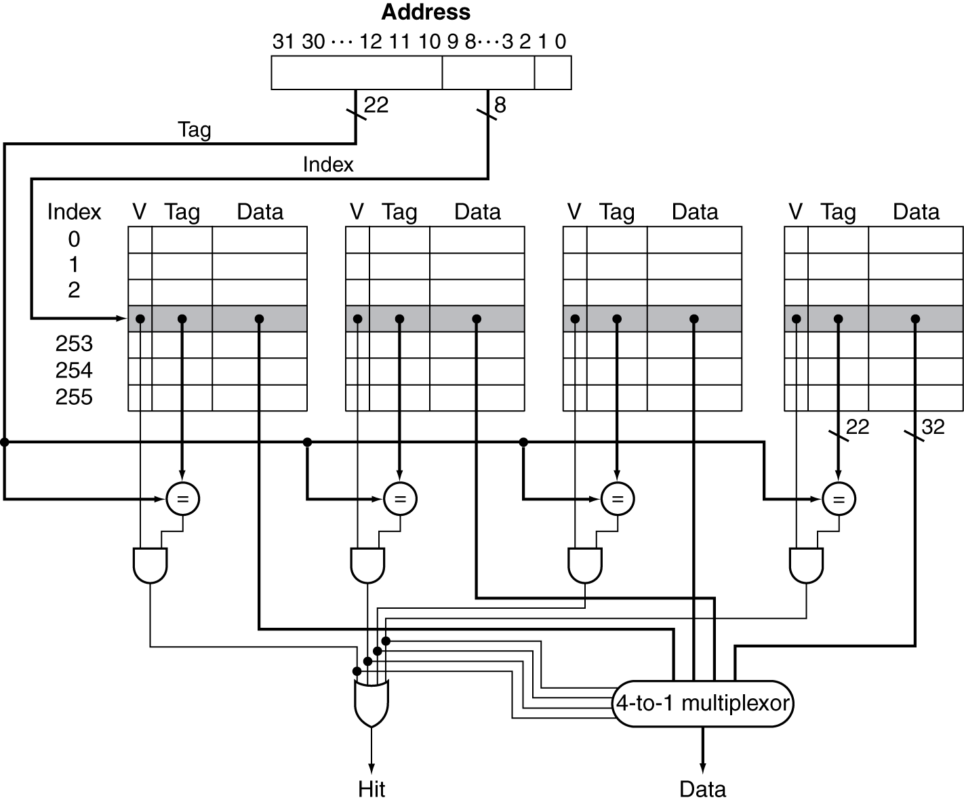
Set Associative Cache Organization

Slide 32
Replacement Policy
Direct mapped: no choice
Set associative
Prefer non-valid entry, if there is one
Otherwise, choose among entries in the set
Least-recently used (LRU)
Choose the one unused for the longest time
Simple for 2-way, manageable for 4-way, too hard beyond that
Random
Gives approximately the same performance as LRU for high associativity

Slide 33
Multilevel Caches
Primary cache attached to CPU
Small, but fast
Level-2 cache services misses from primary cache
Larger, slower, but still faster than main memory
Main memory services L-2 cache misses
Some high-end systems include L-3 cache

Slide 34
Multilevel Cache Example
Given
CPU base CPI = 1, clock rate = 4GHz
Miss rate/instruction = 2%
Main memory access time = 100ns
With just primary cache
Miss penalty = 100ns/0.25ns = 400 cycles
Effective CPI = 1 + 0.02 × 400 = 9

Slide 35
Example (cont.)
Now add L-2 cache
Access time = 5ns
Global miss rate to main memory = 0.5%
Primary miss with L-2 hit
Penalty = 5ns/0.25ns = 20 cycles
Primary miss with L-2 miss
Extra penalty = 420 cycles
CPI = 1 + 0.02 × 20 + 0.005 × 400 = 3.4
Performance ratio = 9/3.4 = 2.6

Slide 36
Multilevel Cache Considerations
Primary cache
Focus on minimal hit time
L-2 cache
Focus on low miss rate to avoid main memory access
Hit time has less overall impact
Results
L-1 cache usually smaller than a single cache
L-1 block size smaller than L-2 block size

Slide 37
Interactions with Advanced CPUs
Out-of-order CPUs can execute instructions during cache miss
Pending store stays in load/store unit
Dependent instructions wait in reservation stations
Independent instructions continue
Effect of miss depends on program data flow
Much harder to analyse
Use system simulation

Slide 38
The Memory Hierarchy
The BIG Picture
Common principles apply at all levels of the memory hierarchy
Based on notions of caching
At each level in the hierarchy
Block placement
Finding a block
Replacement on a miss
Write policy
§5.5 A Common Framework for Memory Hierarchies

Slide 39
Block Placement
Determined by associativity
Direct mapped (1-way associative)
One choice for placement
n-way set associative
n choices within a set
Fully associative
Any location
Higher associativity reduces miss rate
Increases complexity, cost, and access time

Slide 40
Finding a Block
Associativity | Location method | Tag comparisons
Direct mapped | Index | 1
n-way set associative | Set index, then search entries within the set | n
Fully associative | Search all entries | #entries
 | Full lookup table | 0
Hardware caches
Reduce comparisons to reduce cost
Virtual memory
Full table lookup makes full associativity feasible
Benefit in reduced miss rate

Slide 41
Replacement
Choice of entry to replace on a miss
Least recently used (LRU)
Complex and costly hardware for high associativity
Random
Close to LRU, easier to implement
Virtual memory
LRU approximation with hardware support

Slide 42
Write Policy
Write-through
Update both upper and lower levels
Simplifies replacement, but may require write buffer
Write-back
Update upper level only
Update lower level when block is replaced
Need to keep more state
Virtual memory
Only write-back is feasible, given disk write latency

Slide 43
Sources of Misses
Compulsory misses (aka cold start misses)
First access to a block
Capacity misses
Due to finite cache size
A replaced block is later accessed again
Conflict misses (aka collision misses)
In a non-fully associative cache
Due to competition for entries in a set
Would not occur in a fully associative cache of the same total size

Slide 44
Cache Design Trade-offs
Design change | Effect on miss rate | Negative performance effect
Increase cache size | Decrease capacity misses | May increase access time
Increase associativity | Decrease conflict misses | May increase access time
Increase block size | Decrease compulsory misses | Increases miss penalty. For very large block size, may increase miss rate due to pollution.

Slide 45
Cache Control
Example cache characteristics
Direct-mapped, write-back, write allocate
Block size: 4 words (16 bytes)
Cache size: 16 KB (1024 blocks)
32-bit byte addresses
Valid bit and dirty bit per block
Blocking cache
CPU waits until access is complete
31
10
9
4
3
0
Tag
Index
Offset
18 bits
10 bits
4 bits

Slide 46
Interface Signals
CPU
Cache
Memory
Read/Write
Read/Write
Valid
Valid
Address
32
Address
32
Write Data
32
Write Data
128
Read Data
32
Read Data
128
Ready
Ready
Multiple cycles per access

Slide 47
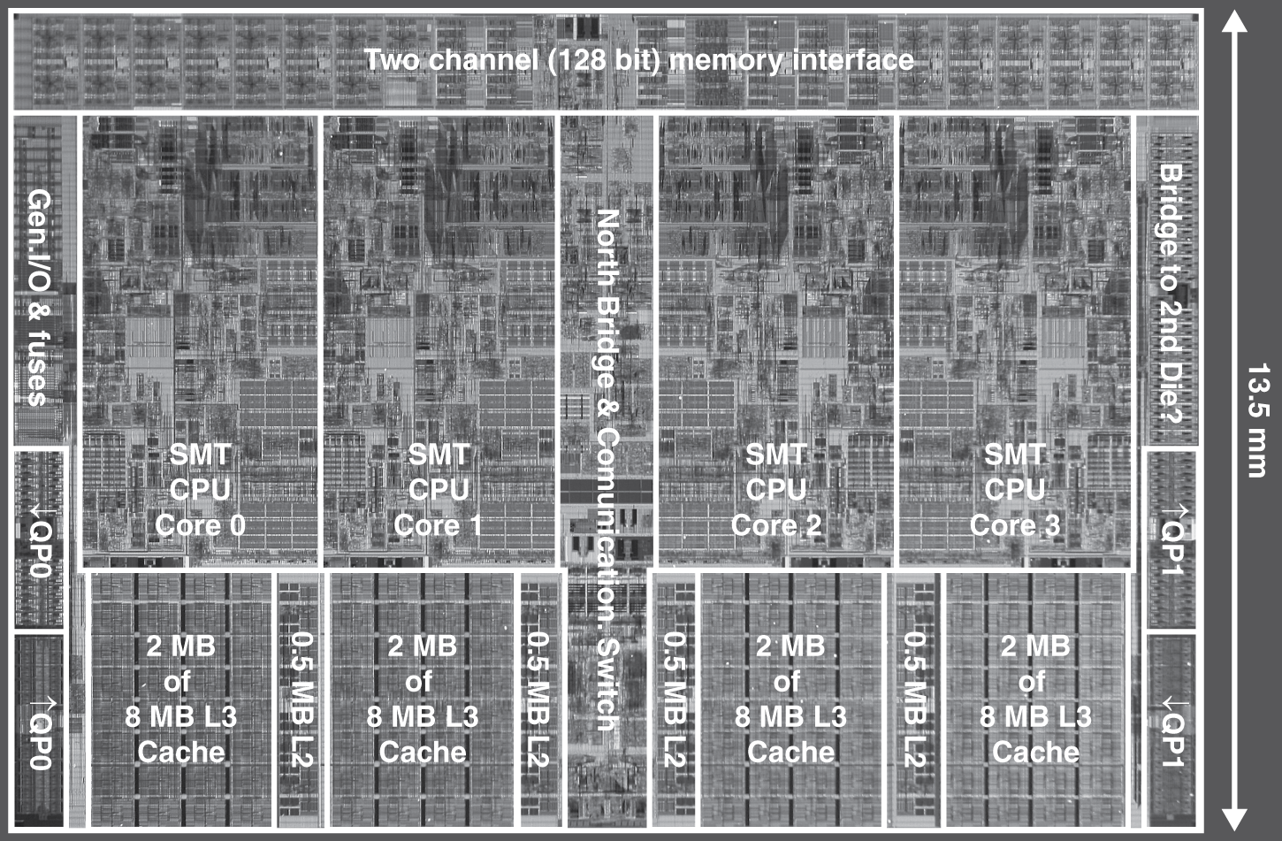
Multilevel On-Chip Caches
Intel Nehalem 4-core processor
Per core: 32KB L1 I-cache, 32KB L1 D-cache, 512KB L2 cache

Slide 48
3-Level Cache Organization
 | Intel Nehalem | AMD Opteron X4
L1 caches (per core) | L1 I-cache: 32KB, 64-byte blocks, 4-way, approx LRU replacement, hit time n/a L1 D-cache: 32KB, 64-byte blocks, 8-way, approx LRU replacement, write-back/allocate, hit time n/a | L1 I-cache: 32KB, 64-byte blocks, 2-way, LRU replacement, hit time 3 cycles L1 D-cache: 32KB, 64-byte blocks, 2-way, LRU replacement, write-back/allocate, hit time 3 cycles
L2 unified cache (per core) | 256KB, 64-byte blocks, 8-way, approx LRU replacement, write-back/allocate, hit time n/a | 512KB, 64-byte blocks, 16-way, approx LRU replacement, write-back/allocate, hit time 9 cycles
L3 unified cache (shared) | 8MB, 64-byte blocks, 16-way, replacement n/a, write-back/allocate, hit time n/a | 2MB, 64-byte blocks, 32-way, replace block shared by fewest cores, write-back/allocate, hit time 38 cycles
n/a: data not available

Slide 49
Way Prediction
To improve hit time, predict the way to pre-set mux
Mis-prediction gives longer hit time
Prediction accuracy
> 90% for two-way
> 80% for four-way
I-cache has better accuracy than D-cache
First used on MIPS R10000 in mid-90s
Used on ARM Cortex-A8
Extend to predict block as well
“Way selection”
Increases mis-prediction penalty
Advanced Optimizations

Slide 50
Pipelining Cache
Pipeline cache access to improve bandwidth
Examples:
Pentium: 1 cycle
Pentium Pro – Pentium III: 2 cycles
Pentium 4 – Core i7: 4 cycles
Increases branch mis-prediction penalty
Makes it easier to increase associativity
Advanced Optimizations

Slide 51
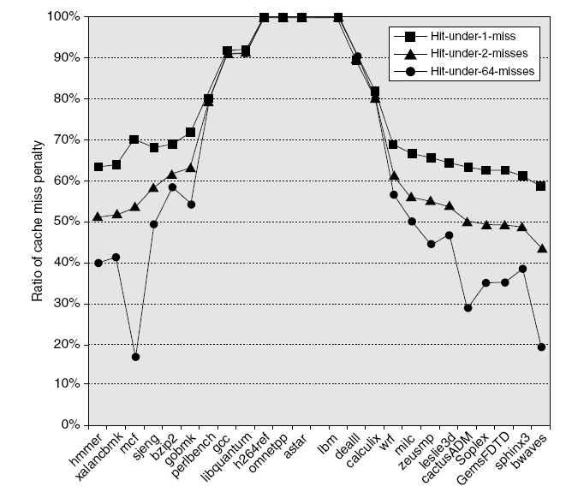
Nonblocking Caches
Allow hits before previous misses complete
“Hit under miss”
“Hit under multiple miss”
L2 must support this
In general, processors can hide L1 miss penalty but not L2 miss penalty
Advanced Optimizations

Slide 52
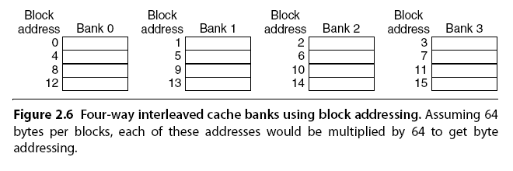
Multibanked Caches
Organize cache as independent banks to support simultaneous access
ARM Cortex-A8 supports 1-4 banks for L2
Intel i7 supports 4 banks for L1 and 8 banks for L2
Interleave banks according to block address
Advanced Optimizations

Slide 53
Critical Word First, Early Restart
Critical word first
Request missed word from memory first
Send it to the processor as soon as it arrives
Early restart
Request words in normal order
Send missed work to the processor as soon as it arrives
Effectiveness of these strategies depends on block size and likelihood of another access to the portion of the block that has not yet been fetched
Advanced Optimizations

Slide 54
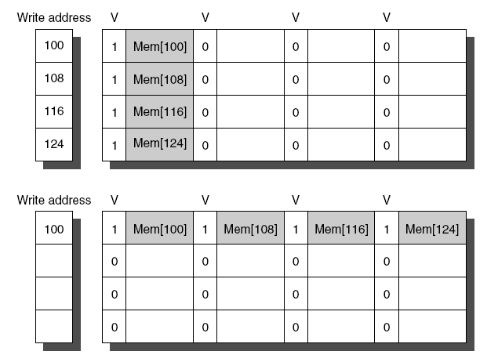
Merging Write Buffer
When storing to a block that is already pending in the write buffer, update write buffer
Reduces stalls due to full write buffer
Do not apply to I/O addresses
Advanced Optimizations
No write buffering
Write buffering

Slide 55
Compiler Optimizations
Loop Interchange
Swap nested loops to access memory in sequential order
Blocking
Instead of accessing entire rows or columns, subdivide matrices into blocks
Requires more memory accesses but improves locality of accesses
Advanced Optimizations

Slide 56
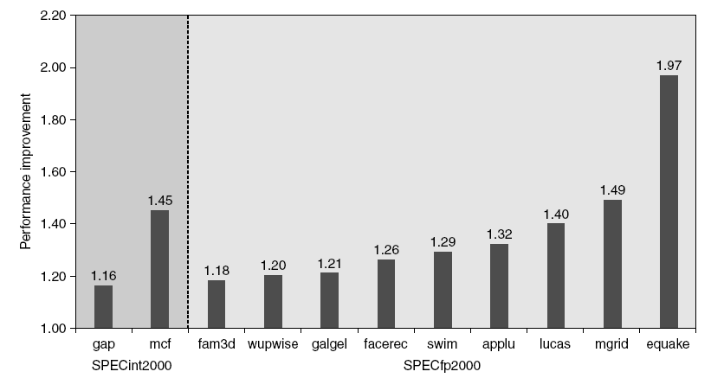
Hardware Prefetching
Fetch two blocks on miss (include next sequential block)
Advanced Optimizations
Pentium 4 Pre-fetching

Slide 57
Compiler Prefetching
Insert prefetch instructions before data is needed
Non-faulting: prefetch doesn’t cause exceptions
Register prefetch
Loads data into register
Cache prefetch
Loads data into cache
Combine with loop unrolling and software pipelining
Advanced Optimizations

Slide 58
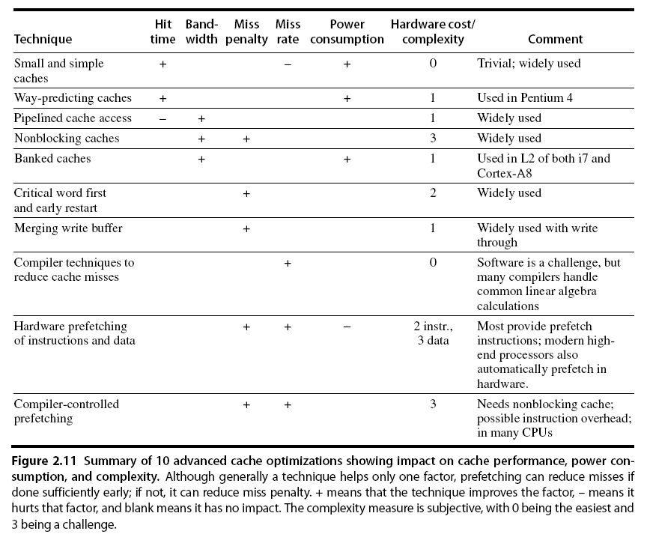
Summary
Advanced Optimizations

Slide 59
Concluding Remarks
Fast memories are small, large memories are slow
We really want fast, large memories ☹
Caching gives this illusion ☺
Principle of locality
Programs use a small part of their memory space frequently
Memory hierarchy
L1 cache ↔ L2 cache ↔ … ↔ DRAM memory ↔ disk
Memory system design is critical for multiprocessors

